Slide 1
Kognitívne vedy: Mozog a myseľ
13.10.2011
Dana Retová

Slide 2
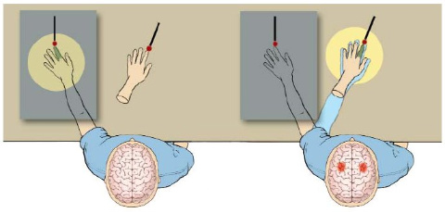
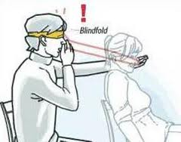
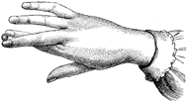
Bodily illusions
Rubber hand illusion
Pinocchio illusion
Aristotle illusion

Slide 4
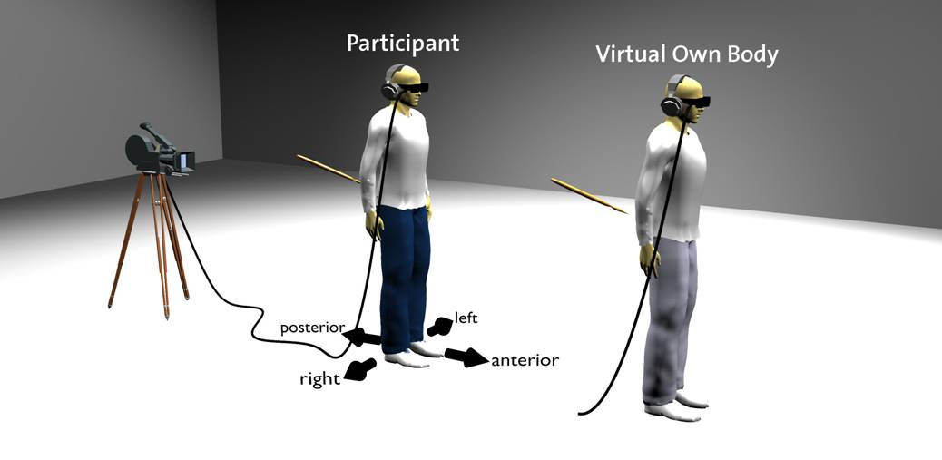
Out of body experience
http://www.youtube.com/watch?v=4PQAc_Z2OfQ

Slide 5
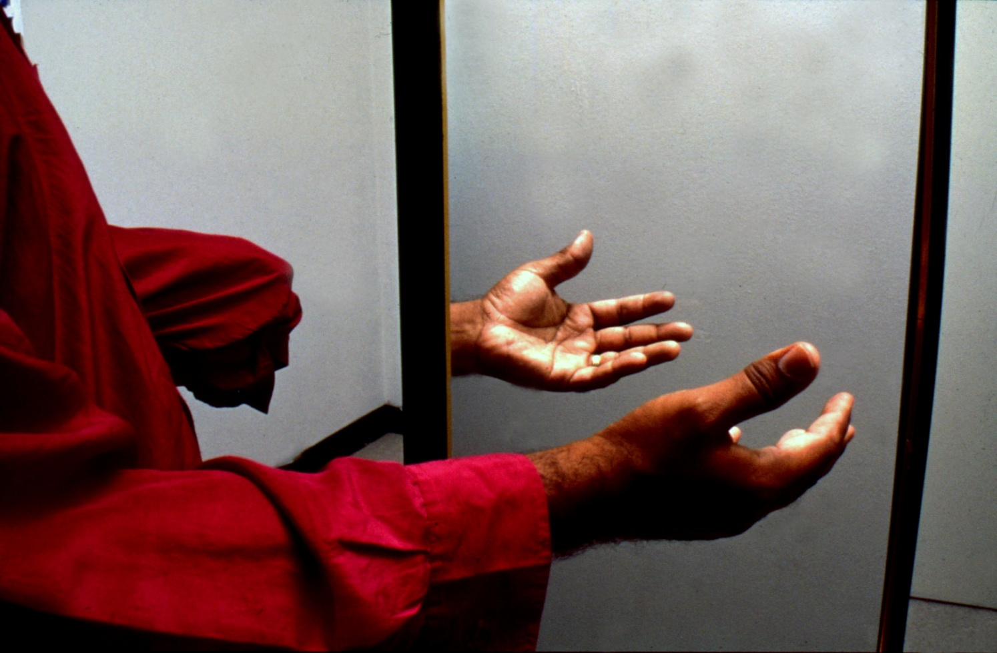
Phantom limbs
VS Ramachandran

